Slide 1


CS 235: User Interface Design February 17 Class Meeting
Department of Computer Science San Jose State University Spring 2015 Instructor: Ron Mak
www.cs.sjsu.edu/~mak

Slide 2
Your Application Prototype
Each team should build a working prototype of its application.
Concentrate on designing a good user interface.
Use UI design patterns.
The prototype doesn’t have to really work.
“Fake it” enough so that looks realistic.
Hard-code the interactions.
OK for some execution paths not to work at all.
Make at least two of your use cases “work”.
Concentrate on designing a good user experience.

Slide 3
Your Application Prototype, cont’d
Bob Nicholson’s favorite wireframe tool:
Balsamic Mockups
https://balsamiq.com
You will perform usability testing with your application prototypes.
Determine how good your UI and UX designs are.
We will study how to perform usability testing starting next week.

Slide 4
Assignment #2: Usability Testing
Each team chooses two interactive use cases from its web application prototype.
Each use case must accomplish a specific task.
A significant task for the application.
Not simply “log in”.

Slide 5
Assignment #2: Usability Testing, cont’d
During usability testing, a student will be chosen to test each team’s application.
Not a student from the client or design teams.
The student tester will attempt each use case with no handholding from the test facilitator.
The test facilitator will be a member of the application’s design team.
The remaining members of the design team will observe and take copious notes.

Slide 6
Assignment #2: Usability Testing, cont’d
Usability tests will occur February 24 and 26.
20 minutes each.
The design team will write a Usability Test Report.
What problems were observed?
What design fault caused each problem?
What improvements can be made?
Before and after screen shots.

Slide 7
Assignment #2: Usability Testing, cont’d
Usability Test Reports due one week after the test.
March 3 and 5.
Go to this website: http://www.sensible.com/rsme.html and watch the “Demo Usability Test” video.
The actual test starts at 6:00 into the video.
During the tests we’ll do in class, you don’t need to do the initial chat.
Notice how the tester and the test facilitator have a constant conversation with each other.

Slide 8

A Good Book on Web Usability

Slide 9
Definitions of Usability
Useful
Does it do something people need done?
Learnable
Can people figure out how to use it?
Memorable
Do they have to relearn it each time they use it?
Effective
Does it get the job done?

Slide 10
Definitions of Usability, cont’d
Efficient
Does it do it with a reasonable amount of time and effort?
Desirable
Do people want it?
Delightful
Is using it enjoyable, or even fun?
“A person of average (or even below average) ability and experience
can figure out how to use the thing to accomplish something without
it being more trouble than it’s worth.”
Don’t Make Me Think, Revisited by Steve Krug
New Riders, 2014

Slide 11
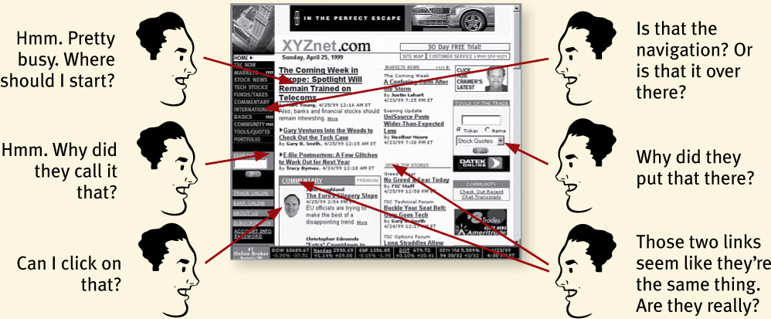
Don’t Make Me Think
You don’t want users to have to think about your page.
Don’t Make Me Think, Revisited by Steve Krug
New Riders, 2014

Slide 12
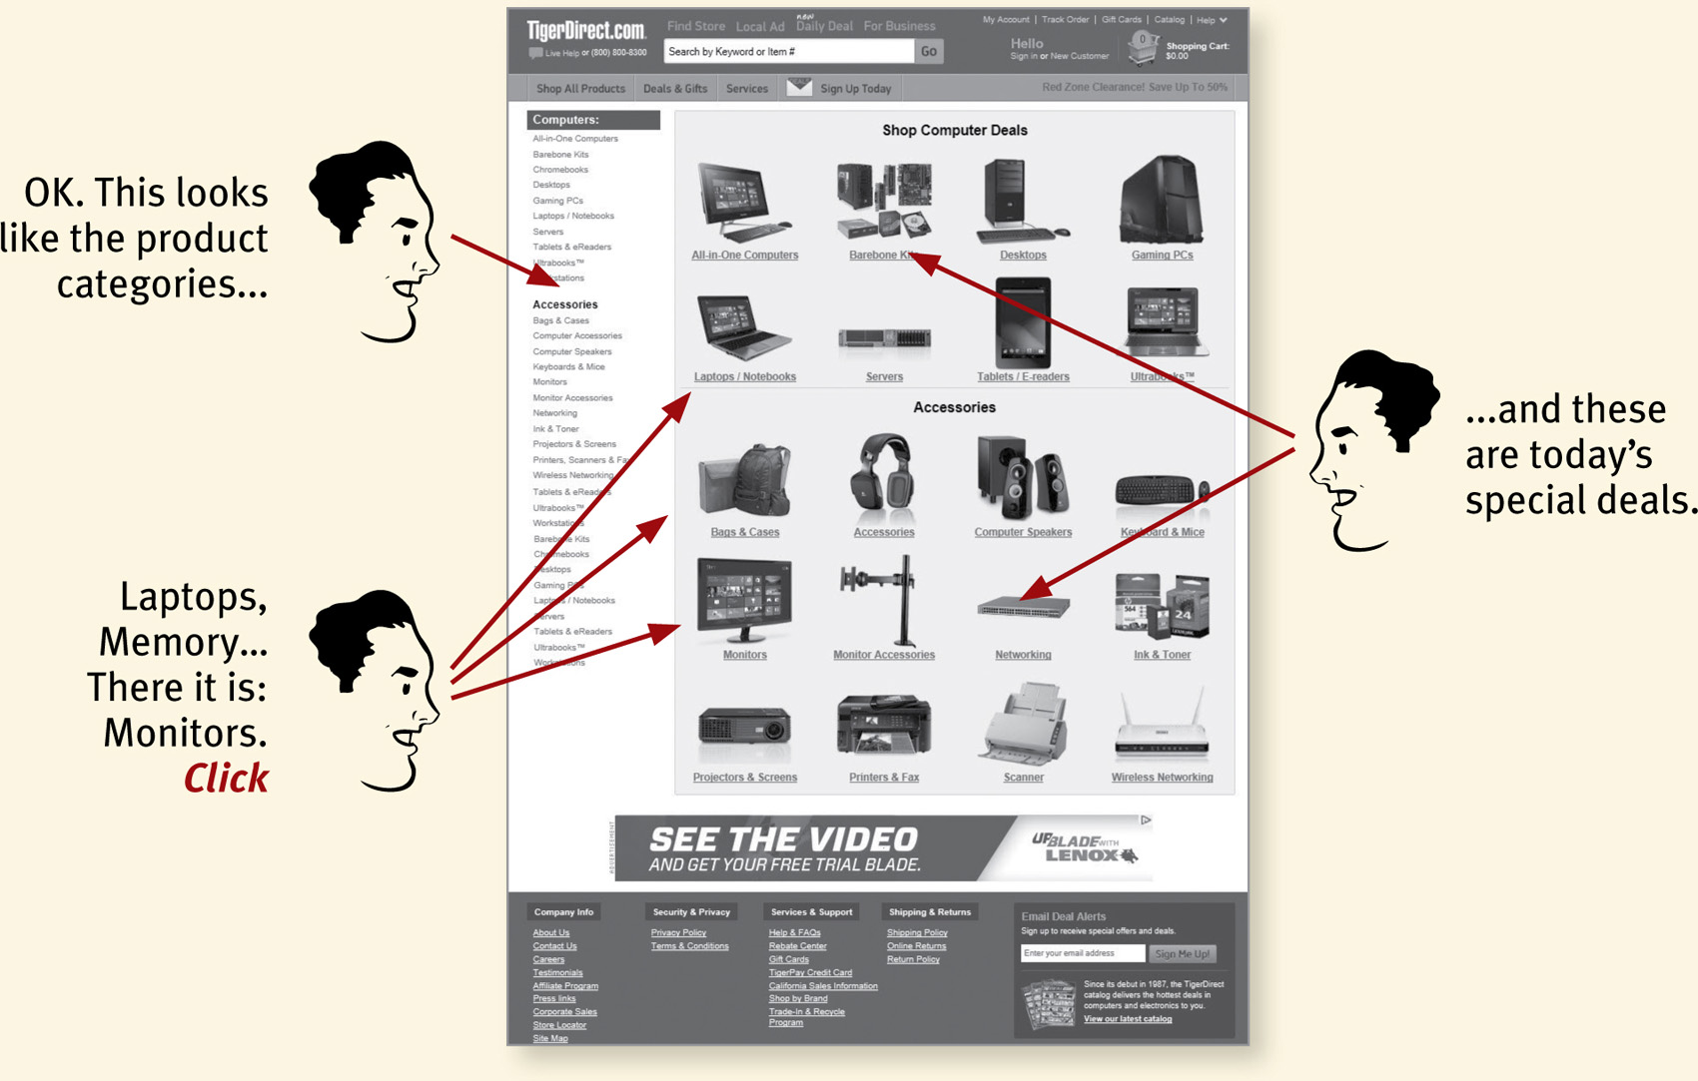
Don’t Make Me Think, cont’d
Things should be immediately obvious.
Don’t Make Me Think, Revisited by Steve Krug
New Riders, 2014

Slide 13
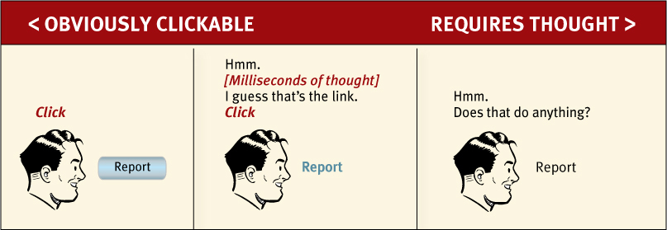
Don’t Make Me Think, cont’d
What is clickable?
Don’t Make Me Think, Revisited by Steve Krug
New Riders, 2014

Slide 14
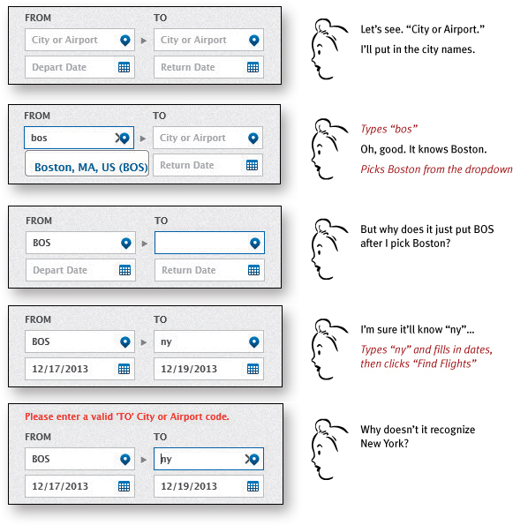
Don’t Make Me Think, cont’d
Booking a flight
Don’t Make Me Think, Revisited by Steve Krug
New Riders, 2014

Slide 15
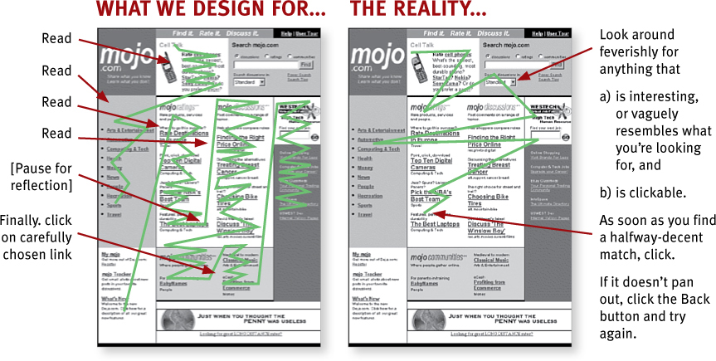
Users Don’t Read Pages
Users scan web pages.
Don’t Make Me Think, Revisited by Steve Krug
New Riders, 2014

Slide 16
Users Scan Web Pages
Users use the web to get something done.
Users know they don’t have to read everything.
Scanning is a basic skill.
Therefore, it must be easy to find the key components of a web page.
Format pages to facilitate scanning.

Slide 17
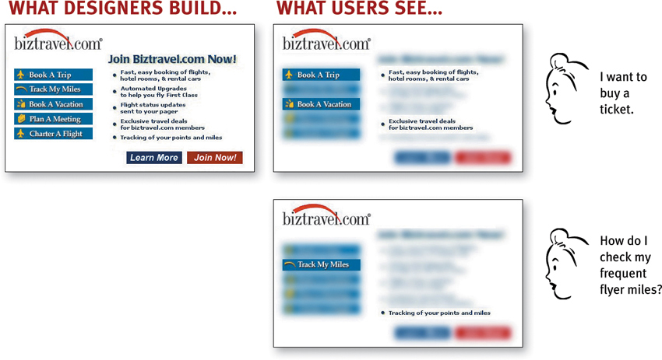
Users Scan Web Pages, cont’d
Don’t Make Me Think, Revisited by Steve Krug
New Riders, 2014

Slide 18
Users “Satisfice”
Users don’t make optimal choices when looking for desired items on web pages.
Instead, users “satisfice” – they make the first reasonable choice.
satisfice = a made-up word that combines “satisfy” + “suffice”

Slide 19


Follow Conventions
Don’t Make Me Think, Revisited by Steve Krug
New Riders, 2014

Slide 20
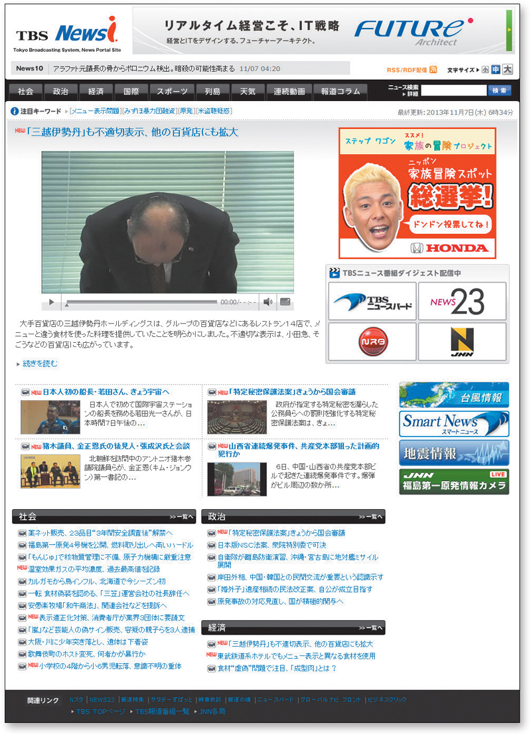
Follow Conventions, cont’d
Even if you don’t read Japanese, you can figure out what’s on this page.
Don’t Make Me Think, Revisited by Steve Krug
New Riders, 2014

Slide 21
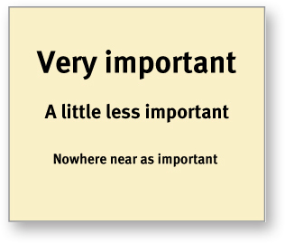
Create Effective Visual Hierarchies
The more important something is, the more prominent it should be.
Don’t Make Me Think, Revisited by Steve Krug
New Riders, 2014

Slide 22
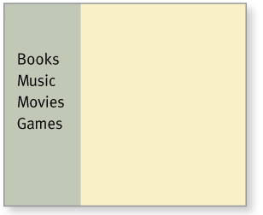
Create Effective Visual Hierarchies, cont’d
Things that are related logically should be related visually.
Don’t Make Me Think, Revisited by Steve Krug
New Riders, 2014

Slide 23
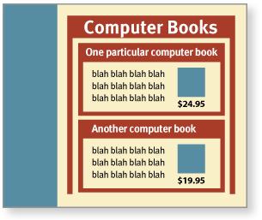
Create Effective Visual Hierarchies, cont’d
Use nesting to show what is part of what.
Don’t Make Me Think, Revisited by Steve Krug
New Riders, 2014

Slide 24
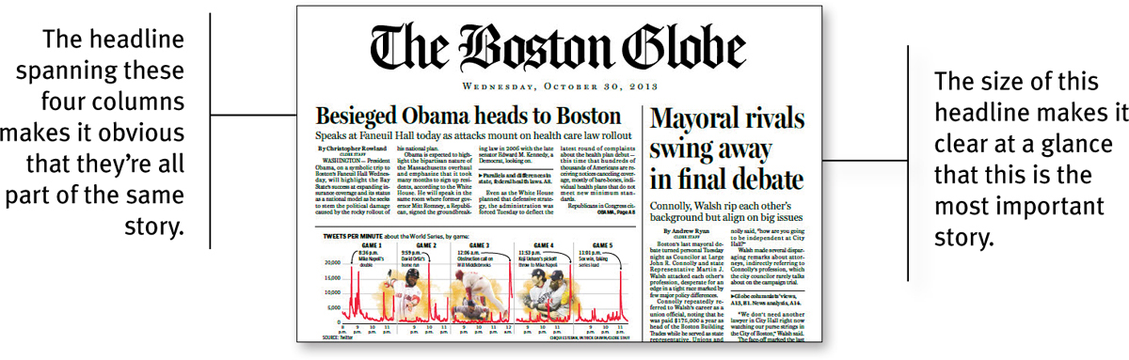
Create Effective Visual Hierarchies, cont’d
Don’t Make Me Think, Revisited by Steve Krug
New Riders, 2014

Slide 25
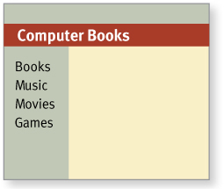
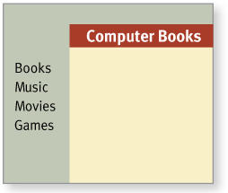
Create Effective Visual Hierarchies, cont’d
Break pages into clearly defined areas.
Wrong
Right
Don’t Make Me Think, Revisited by Steve Krug
New Riders, 2014

Slide 26
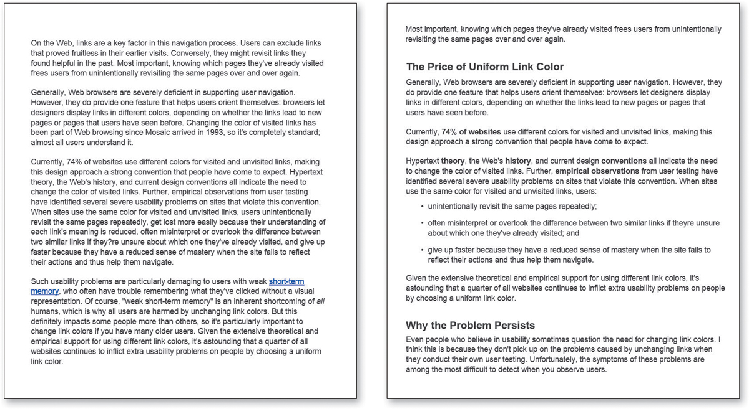
Format Text to Support Scanning
Which would you rather scan?
Don’t Make Me Think, Revisited by Steve Krug
New Riders, 2014

Slide 27
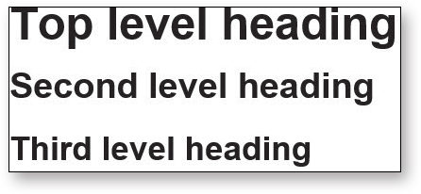
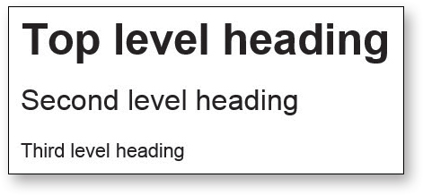
Format Text to Support Scanning, cont’d
Use headings that are well differentiated.
Bad
Better
Don’t Make Me Think, Revisited by Steve Krug
New Riders, 2014

Slide 28
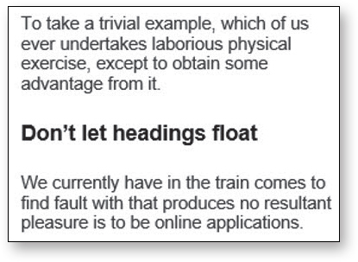
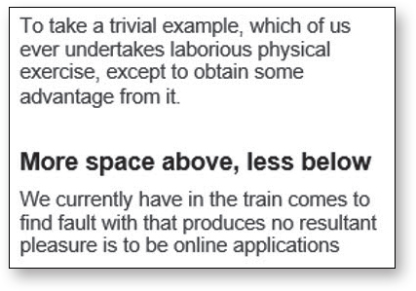
Format Text to Support Scanning, cont’d
Don’t let headings “float”.
Don’t Make Me Think, Revisited by Steve Krug
New Riders, 2014

Slide 29
Following the “Scent of Information”
Users don’t mind clicking a lot to find desired information on a website as long as:
Each click is painless.
They have continued confidence that they’re on the right track to finding their information “prey”.

Slide 30
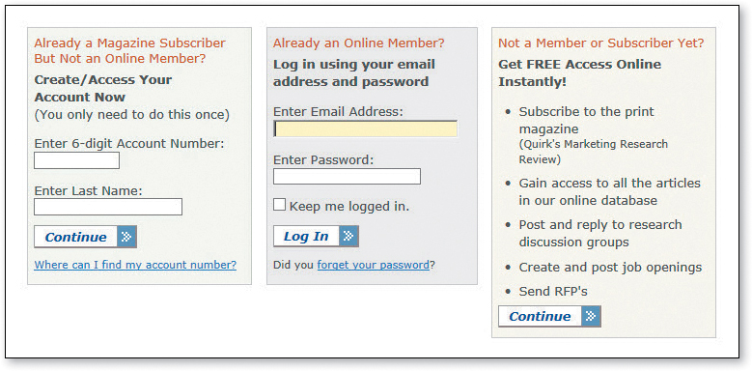
Avoid Showing Confusing Options
A confused user may decide it’s not worth it.
Don’t Make Me Think, Revisited by Steve Krug
New Riders, 2014

Slide 31
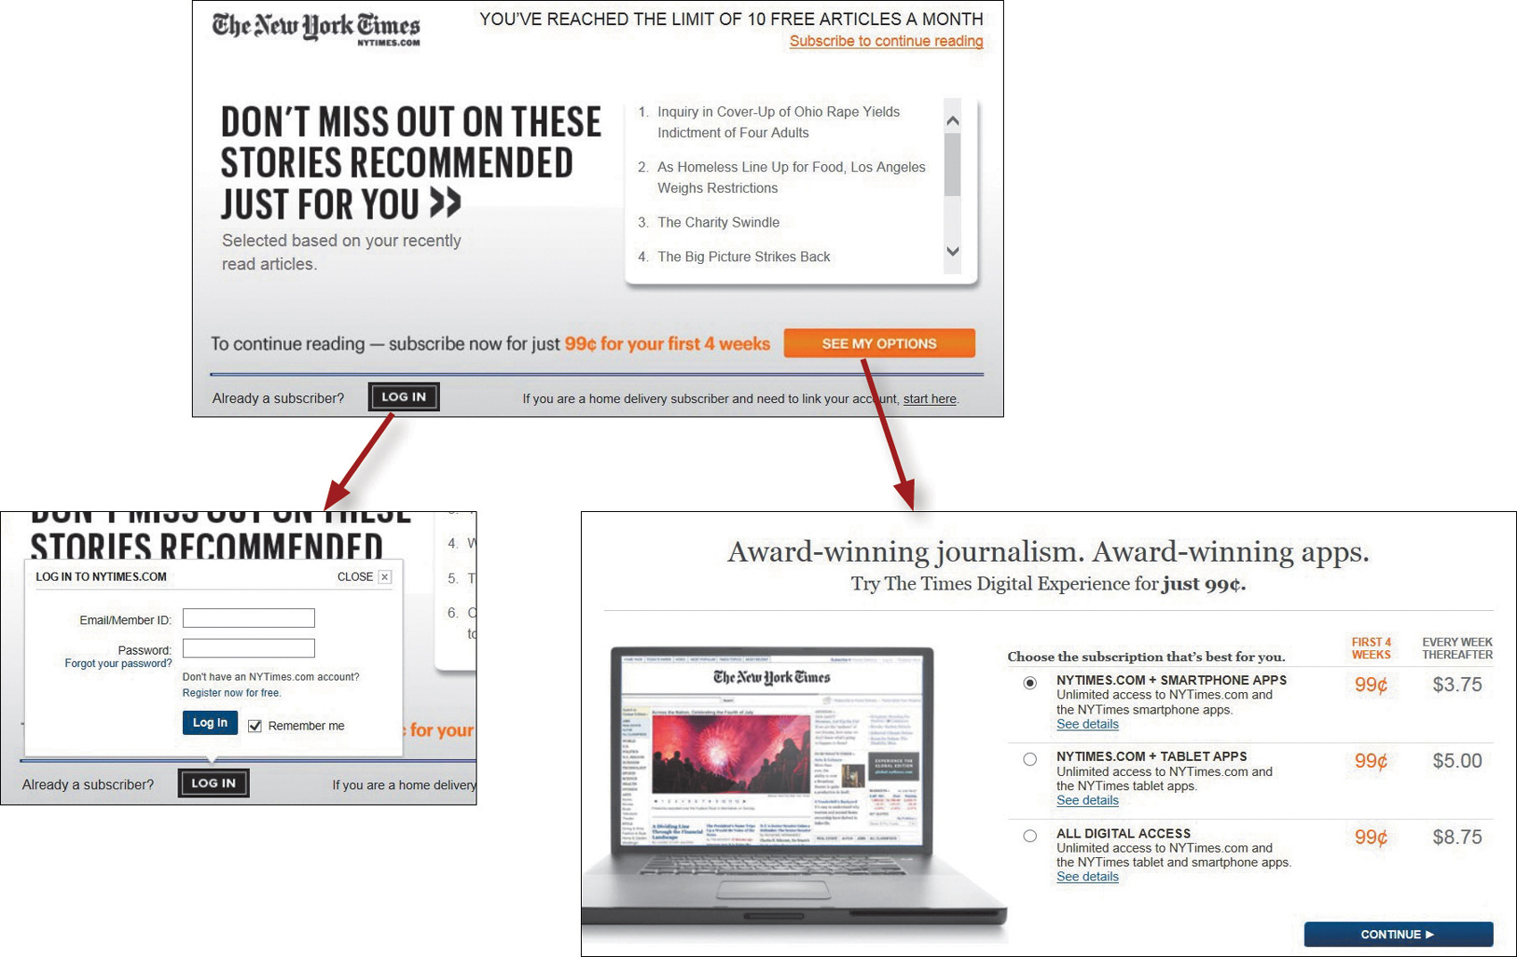
Avoid Showing Confusing Options, cont’d
Display only relevant options.
Don’t Make Me Think, Revisited by Steve Krug
New Riders, 2014

Slide 32
The Home Page
What is the big picture?
What is this website about?
Users must be able to answer these questions within the first few seconds.
The first few seconds a user spends on a new website are critical.
You must quickly get the main point across.

Slide 33
The Home Page, cont’d
Not every visitor to your website will start with the home page.
The user may actually start with some internal page after following a link.
Therefore, make it easy to return to the home page from every page.

Slide 34
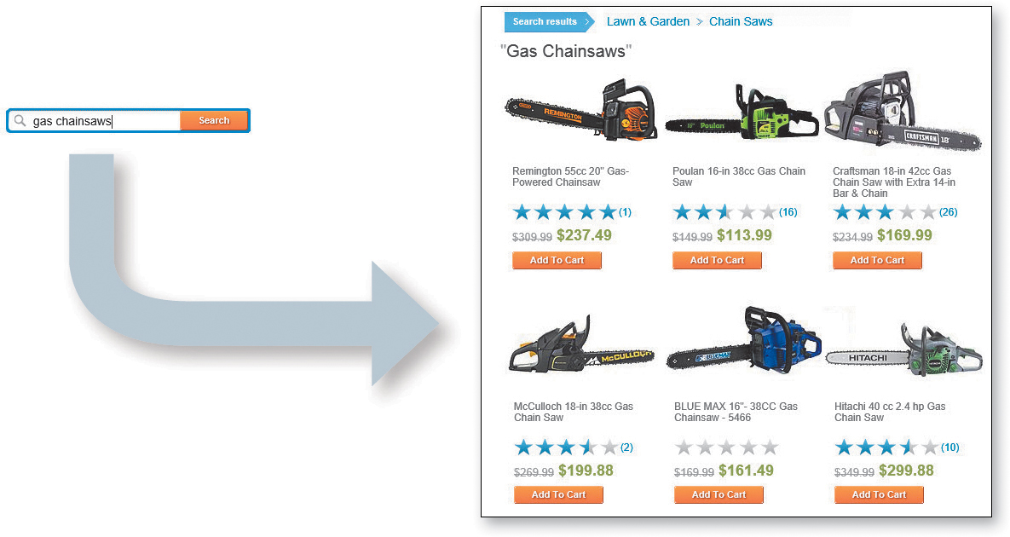
Web Navigation
“Search-dominant” users look for a search box as soon as they enter a site.
In a physical store, they immediately look for a clerk.
Don’t Make Me Think, Revisited by Steve Krug
New Riders, 2014

Slide 35

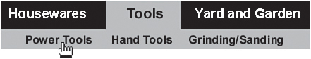
Web Navigation, cont’d
“Link-dominant” users want to browse first.
They search only after running out of links or they’ve gotten sufficiently frustrated.
Don’t Make Me Think, Revisited by Steve Krug
New Riders, 2014

Slide 36
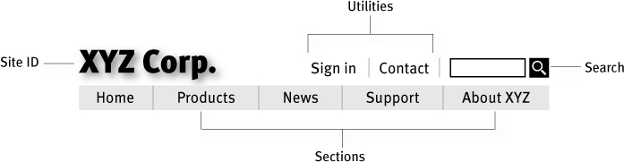
Persistent Navigation
The set of navigation elements that appear on every page of a site.
AKA global navigation
Don’t Make Me Think, Revisited by Steve Krug
New Riders, 2014

Slide 37
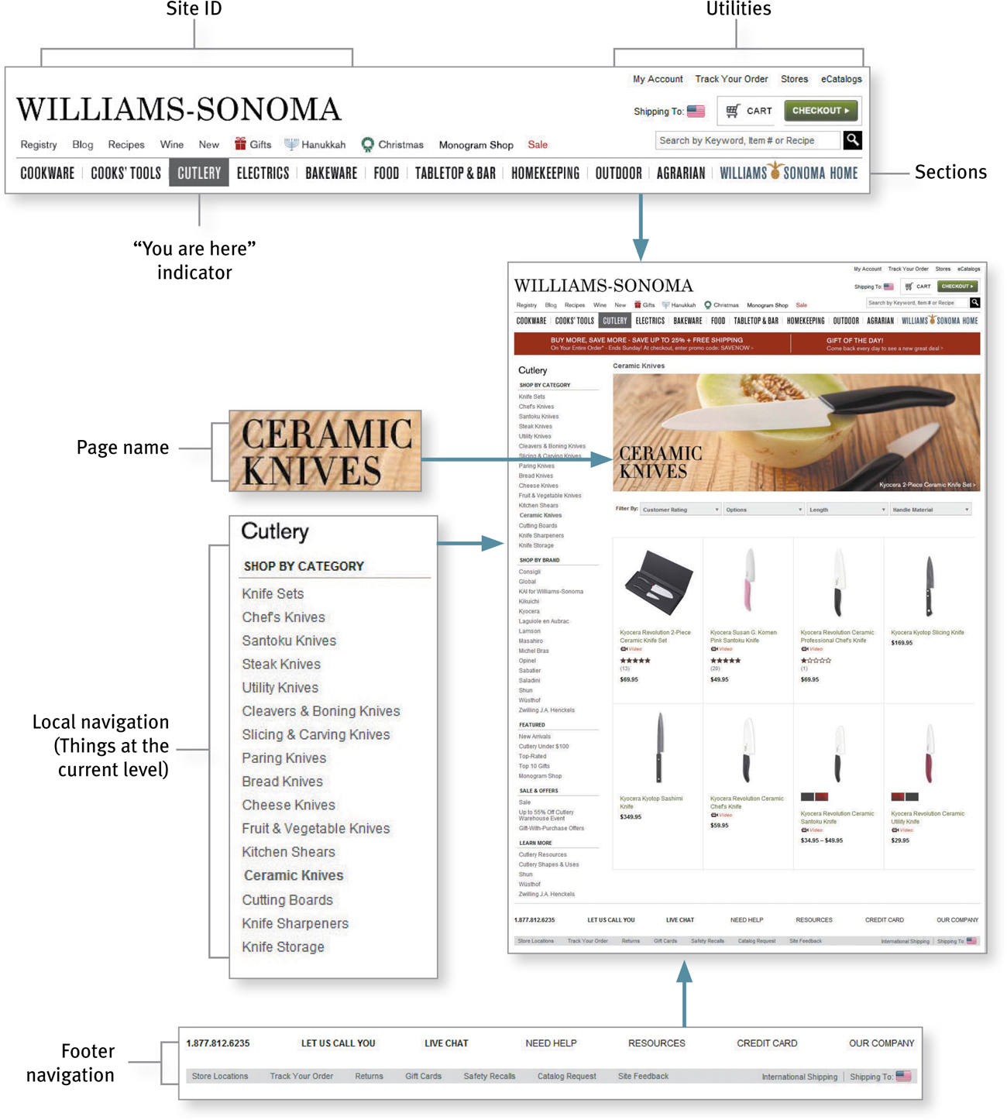
Web Navigation Conventions
Don’t Make Me Think, Revisited by Steve Krug
New Riders, 2014

Slide 38
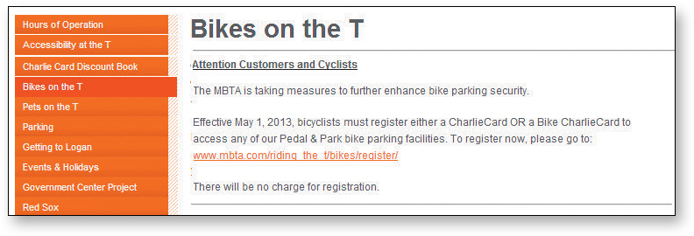
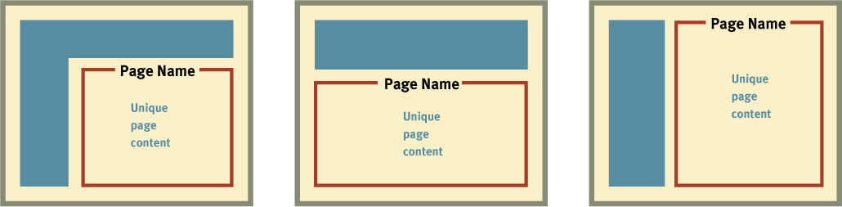
Give Every Page a Name
The page name should be prominent.
Don’t Make Me Think, Revisited by Steve Krug
New Riders, 2014

Slide 39
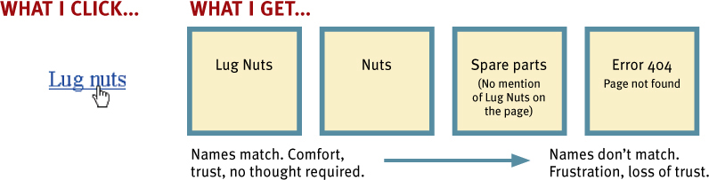
Use Page Names Consistently
Don’t Make Me Think, Revisited by Steve Krug
New Riders, 2014

Slide 40
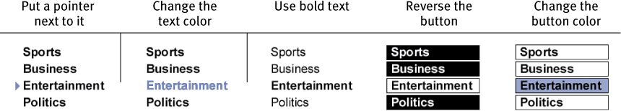
“You are Here”
Make the current location stand out.
Don’t Make Me Think, Revisited by Steve Krug
New Riders, 2014

Slide 41
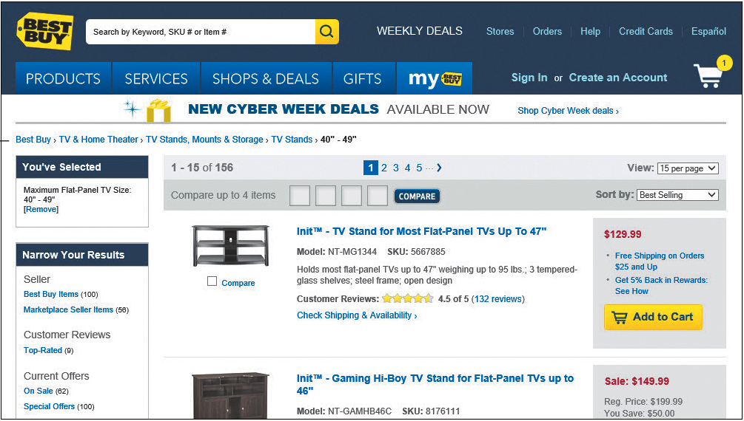
“You are Here”, cont’d
“Breadcrumbs” show you where you are and how you got there.
Don’t Make Me Think, Revisited by Steve Krug
New Riders, 2014

Slide 42
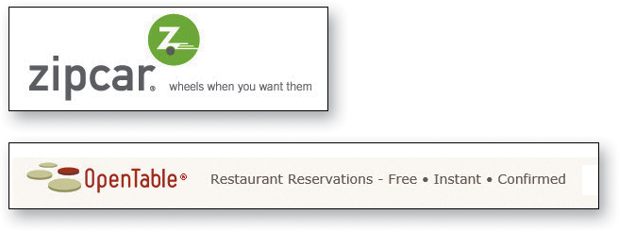
Website Taglines
Good taglines are clear and informative and explain exactly what your website or your organization does.
Don’t Make Me Think, Revisited by Steve Krug
New Riders, 2014

Slide 43

Website Taglines, cont’d
Good taglines are just long enough, but not too long.
Six to eight words seem long enough to convey a full thought, but short enough to absorb easily.
Don’t Make Me Think, Revisited by Steve Krug
New Riders, 2014

Slide 44
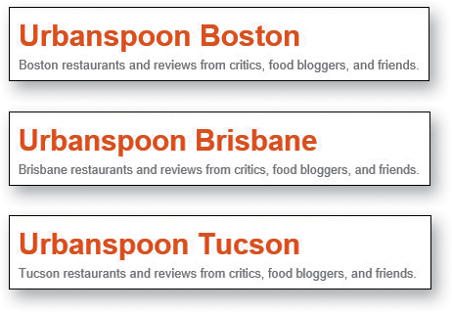
Website Taglines, cont’d
Good taglines convey differentiation and a clear benefit.
A really good tagline is one that no one else in the world could use except you.
Don’t Make Me Think, Revisited by Steve Krug
New Riders, 2014

Slide 45

Website Taglines, cont’d
Bad taglines sound generic.
Don’t Make Me Think, Revisited by Steve Krug
New Riders, 2014

Slide 46

Website Taglines, cont’d
Good taglines are personable, lively, and sometimes clever.
Clever is good, but only if the cleverness helps convey—not obscure—the benefit.
Don’t Make Me Think, Revisited by Steve Krug
New Riders, 2014

